Slide 1
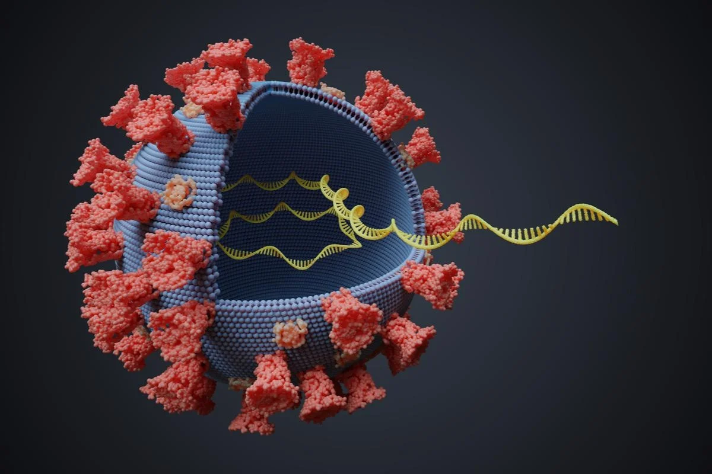
Viral RNA Classification and Interpretation
02May2025
Abby Mitchell, James McTighe, Juliet James, Robert Goins, Trisha Kholiya

Slide 2
Agenda
1.
Defining the Problem
2.
Data Source
3.
Data Cleaning / EDA
4.
Binary classification ANN
5.
Binary classification CNN
6.
Multi species Classification CNN
7.
Identifying Predictive RNA Regions
8.
Autoencoder + Transformer
9.
Conclusion and Next Steps

Slide 3
Agenda
1.
Defining the Problem
2.
Data Source
3.
Data Cleaning / EDA
4.
Binary classification ANN
5.
Binary classification CNN
6.
Multi species Classification CNN
7.
Identifying Predictive RNA Regions
8.
Autoencoder + Transformer
9.
Conclusion and Next Steps

Slide 4
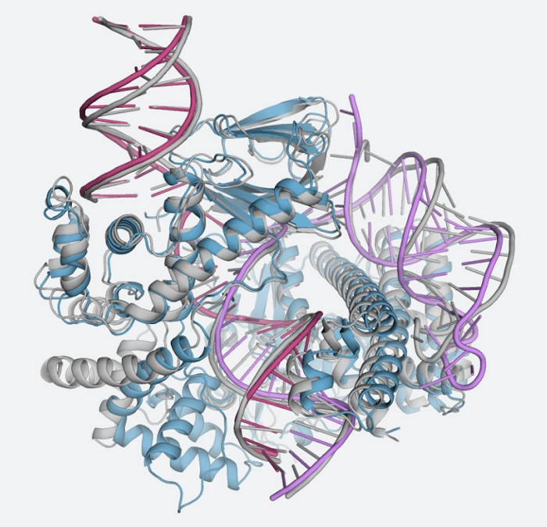
Project Goals: Classifying and Interpreting Viral RNA
0. (Failed Goal): Determining the 3D Structure of RNA based on its sequence.
1. Build a binary classifier that can distinguish whether a viral RNA sequence infects humans or not.
2. Extend model to multi-species classification.
3. Identify key regions of RNA.
4. (Stretch goal) Can we train a model to reconstruct missing parts of viral RNA sequences for RNA sequences that infect humans?

Slide 5
Agenda
1.
Defining the Problem
2.
Data Source
3.
Data Cleaning / EDA
4.
Binary classification ANN
5.
Binary classification CNN
6.
Multi species Classification CNN
7.
Identifying Predictive RNA Regions
8.
Autoencoder + Transformer
9.
Conclusion and Next Steps

Slide 6

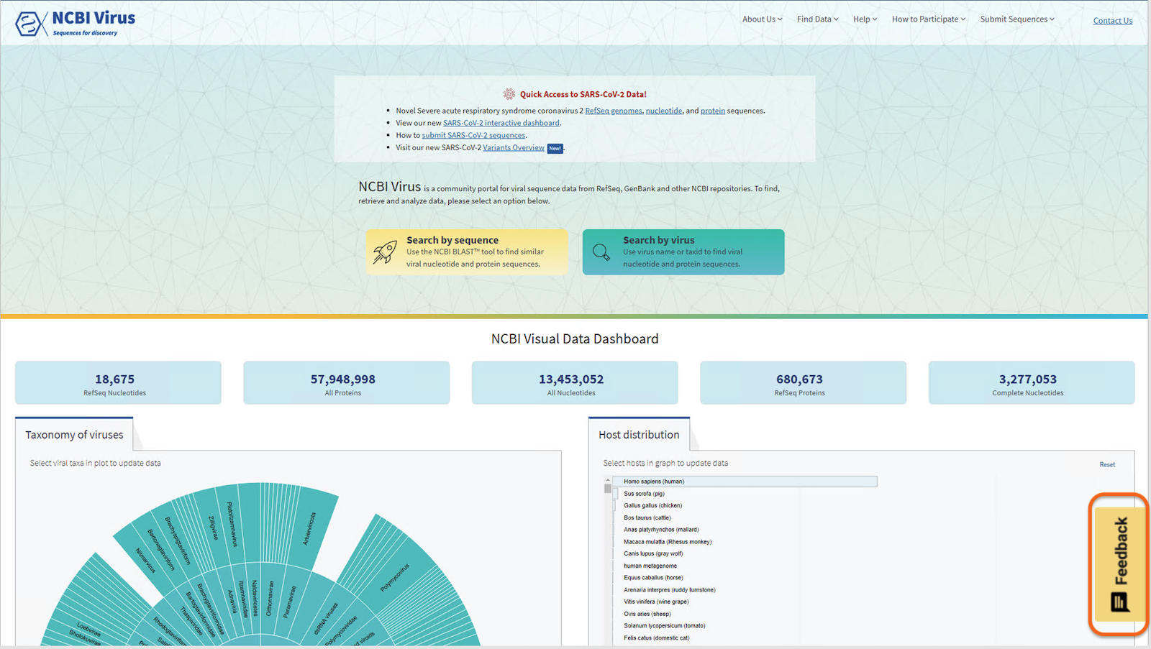
Database
Public dataset hosted by the NCBI Virus Sequence Portal
Focused on nucleotide sequences of RNA viruses
Includes many virus types
Dataset includes:
Metadata (host/viral family/etc.)
Genomic Sequences

Slide 7
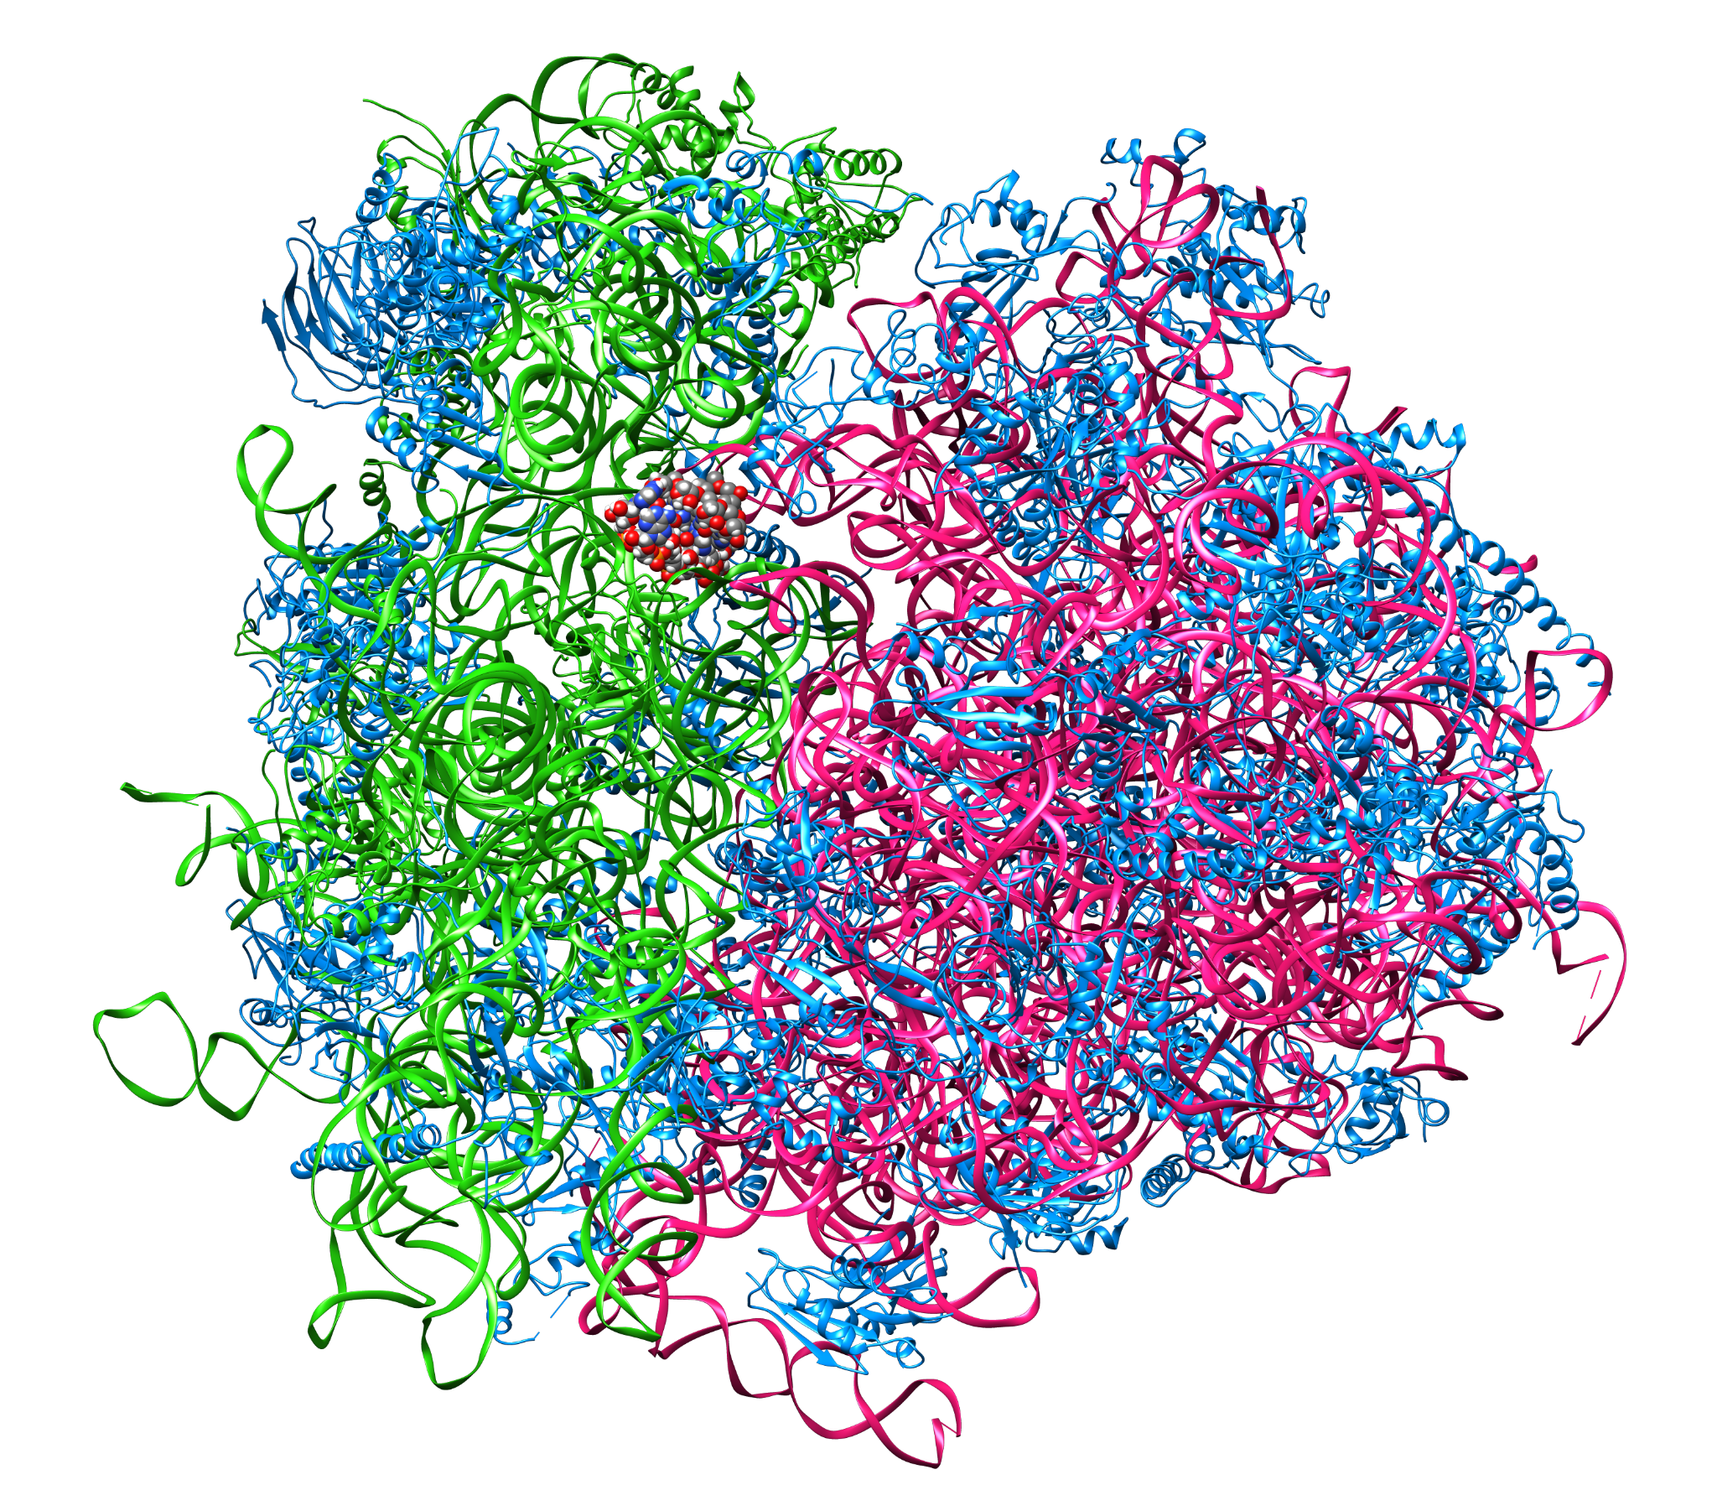
Why Study RNA Viruses?
RNA viruses are responsible for many high-impact diseases:
High mutation rates
Early detection of host specificity can:
Support outbreak monitoring
Aid in vaccine development
Enhance biosecurity & pandemic preparedness

Slide 8
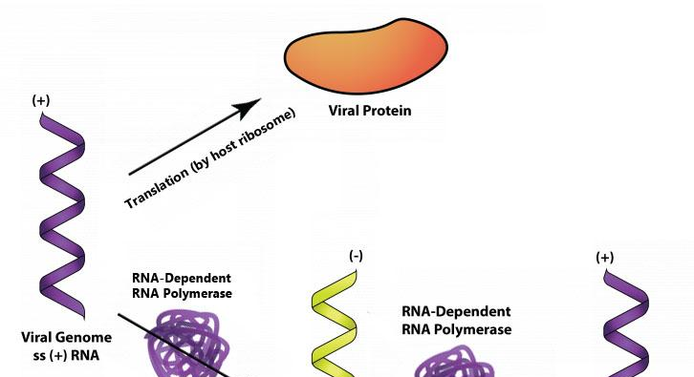
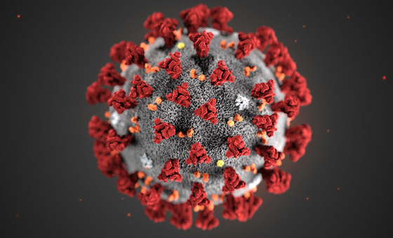
Understanding our Viral RNA Types
+ssRNA
-ssRNA
RNA genome can be directly translated into proteins by host ribosome
Ex. SARS-CoV-2, Zika, Dengue
RNA genome must first be transcribed to +ssRNA
Ex. Influenza, Ebola, Rabies

Slide 9


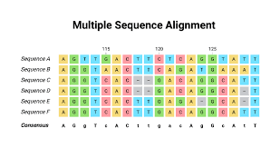
Our Work in the Research Landscape
Prior work has focused on:
Lab Work
Alignment (i.e. BLAST)
Machine Learning:
Random Forests
RNAVirHost

Slide 10
Agenda
1.
Defining the Problem
2.
Data Source
3.
Data Cleaning / EDA
4.
Binary classification ANN
5.
Binary classification CNN
6.
Multi species Classification CNN
7.
Identifying Predictive RNA Regions
8.
Autoencoder + Transformer
9.
Conclusion and Next Steps

Slide 11
Data cleaning for binary + multi species classification

Slide 12
RNA Encoding
Symbol | Meaning
a | adenine
g | guanine
c | cytosine
t | t; thymine in DNA; uracil in RNA
m | a or c
r | a or g
w | a or t
s | c or g
y | c or t
k | g or t
v | a or c or g; not t
h | a or c or t; not g
d | a or g or t; not c
b | c or g or t; not a
n | a or c or g or t
The FASTA format represents nucleotide or amino acid sequences. Each sequence is represented with a header line starting with a ">", followed by lines containing the sequence data, with each base or amino acid represented by a single-letter code
Notes:
from BioPy import SeqIO

Slide 13
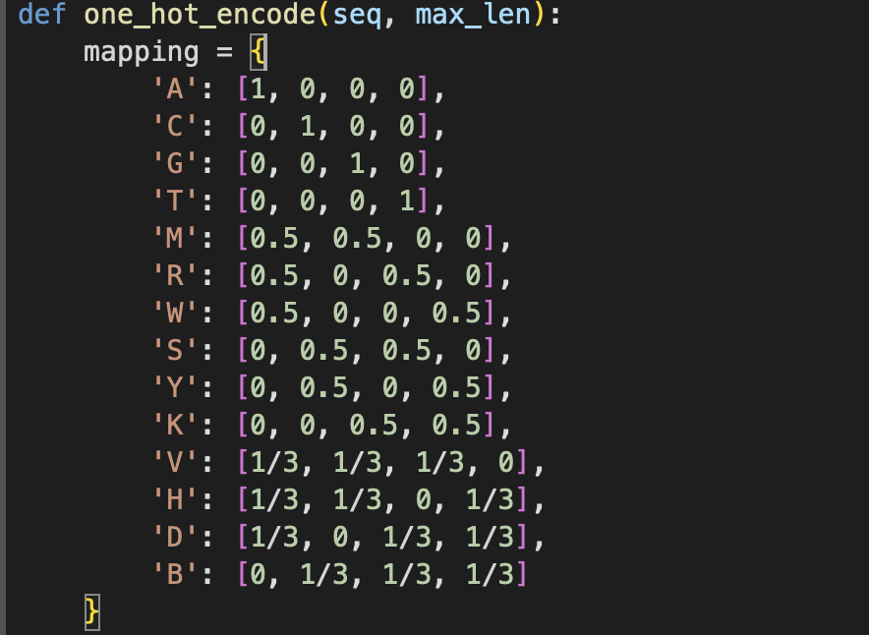
One hot encoding of nucleotides

Slide 14
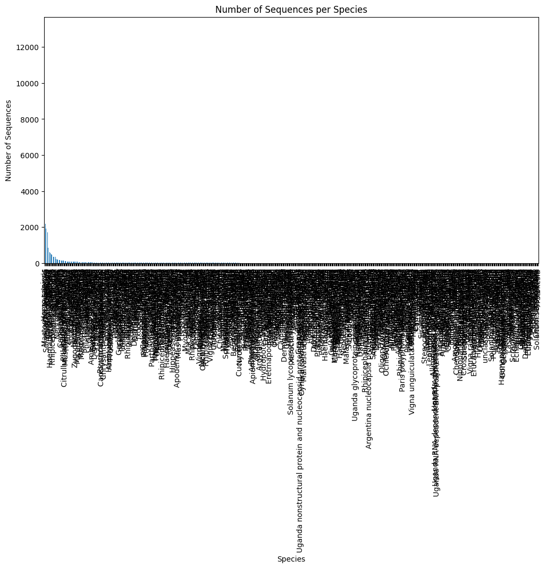
Too much data

Slide 15
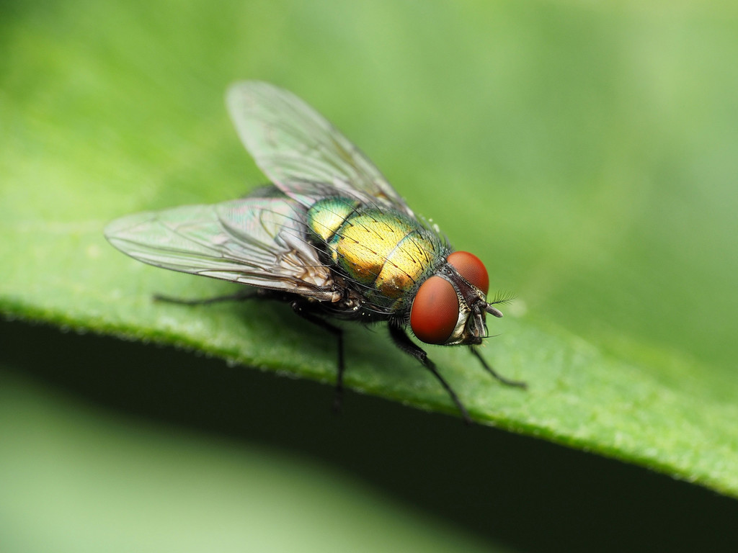
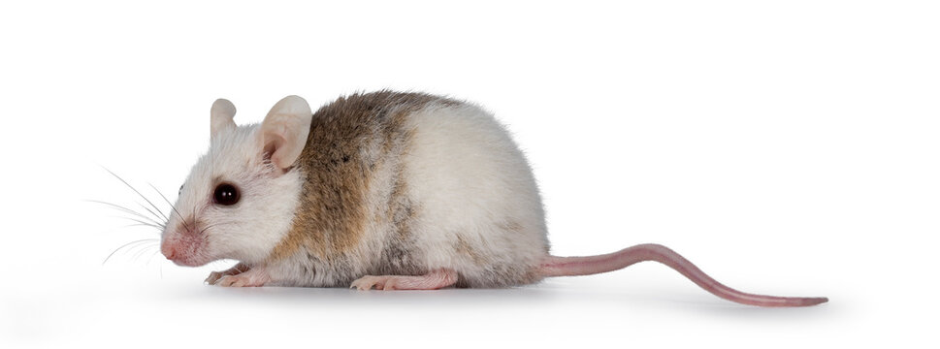
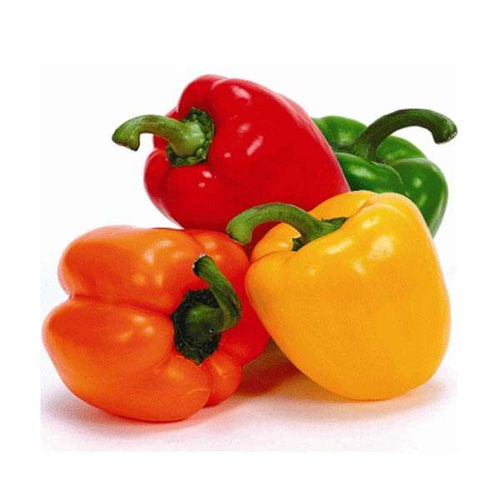

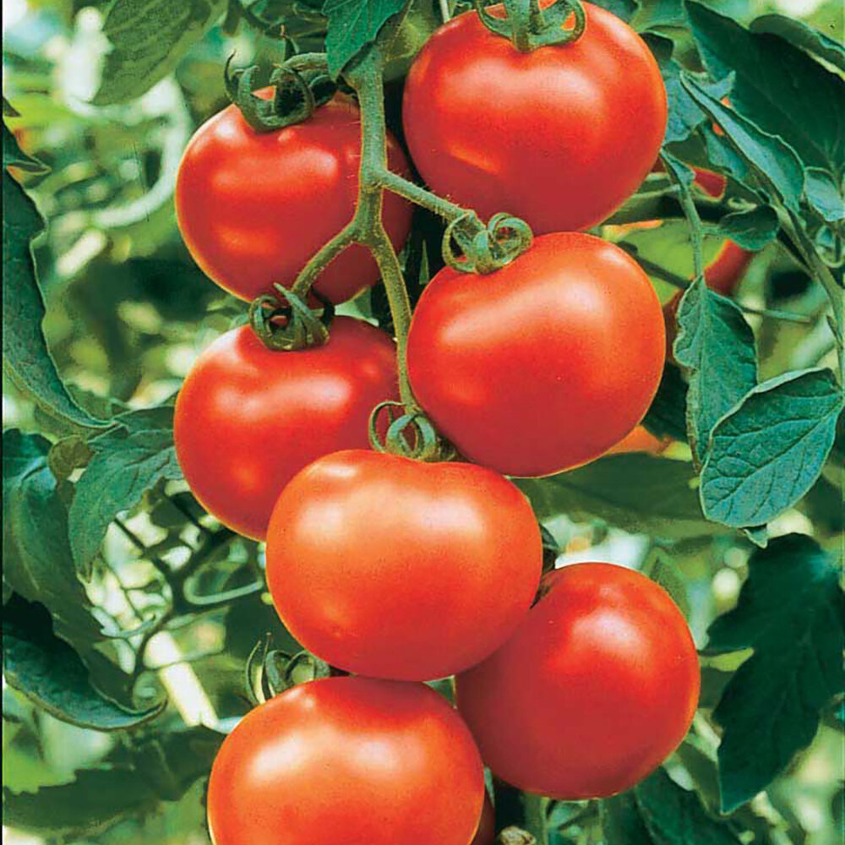


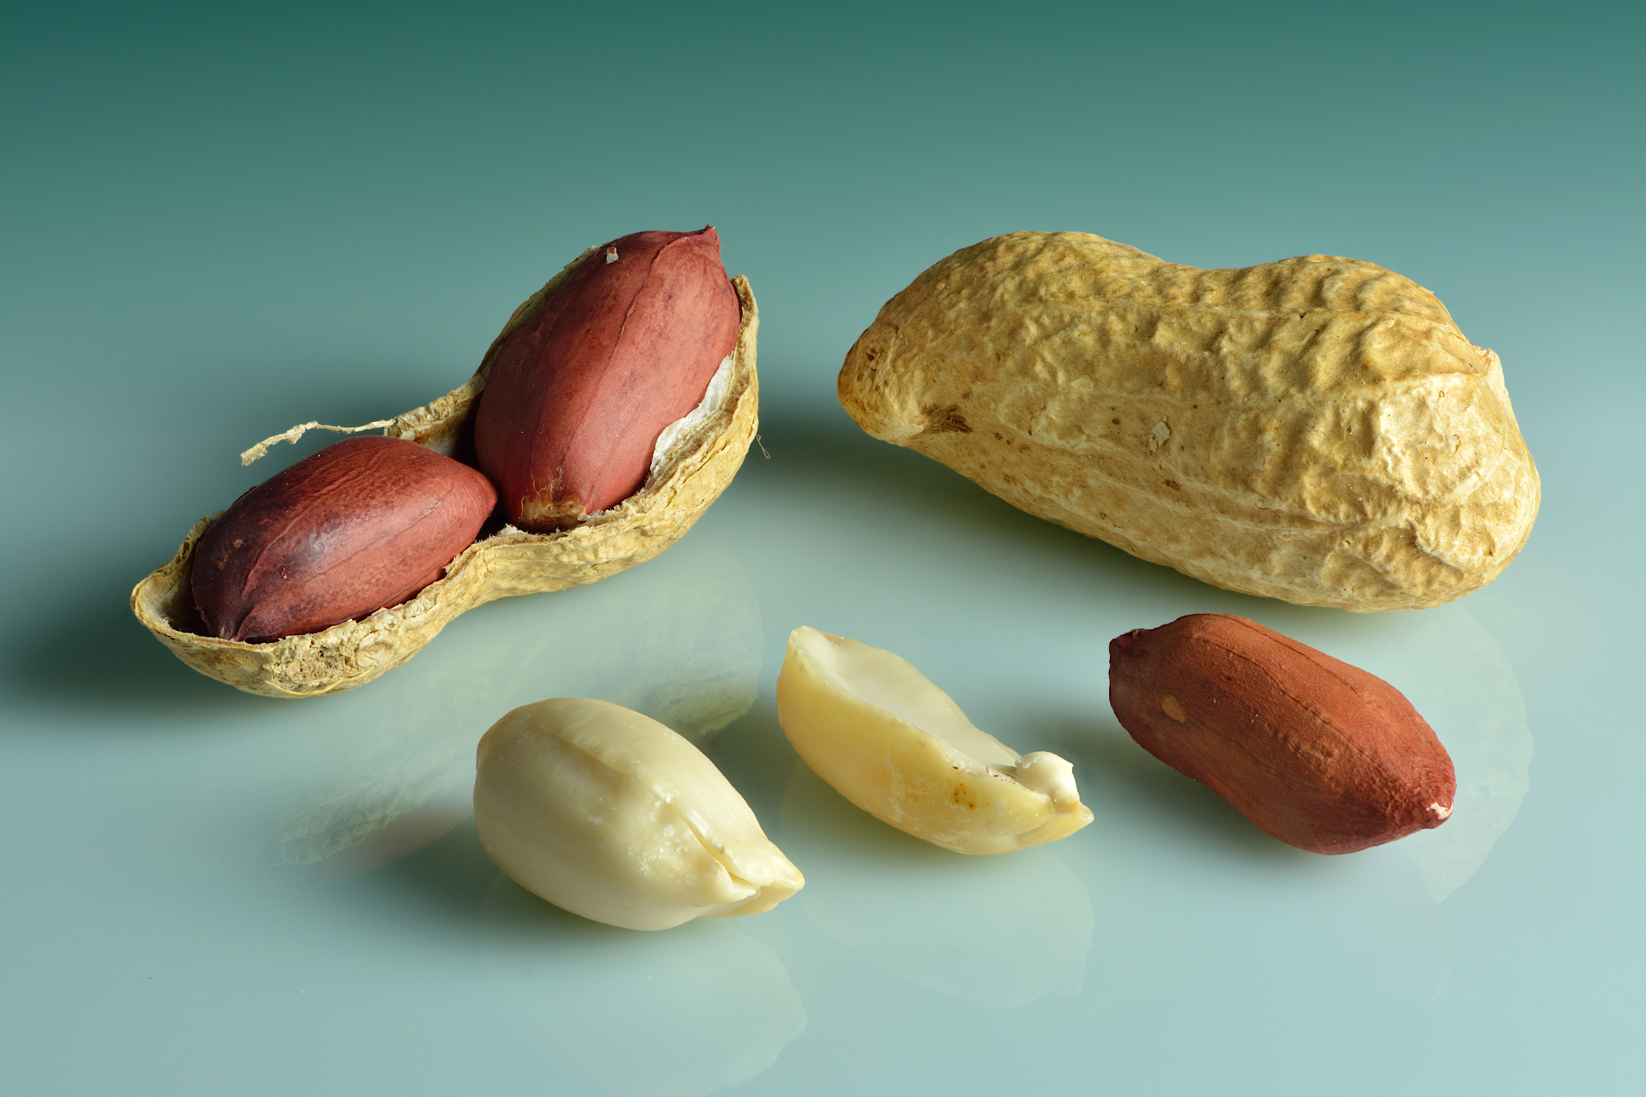
Our top 8 species
Host Name | Common Name | Initial sample size | Reduced sample size
Homo sapiens | Human | 9112 | 423
Diptera | Fly | 440 | 423
Mastomys natalensis | Natal multimammate mouse | 1255 | 423
Solanum lycopersicum | Tomato | 1125 | 423
Capsicum | habanero | 864 | 423
Archis hypogaea | peanut | 1231 | 423
Capsicum annum | bell pepper | 606 | 423
Nicotiana tabacum | cultivated tobacco | 423 | 423

Slide 16
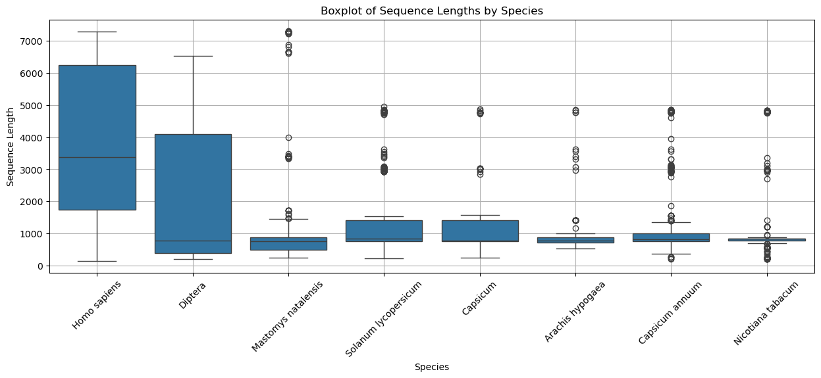
Viral
Sequence Length and Padding

Slide 17
Agenda
1.
Defining the Problem
2.
Data Source
3.
Data Cleaning / EDA
4.
Binary classification ANN
5.
Binary classification CNN
6.
Multi species Classification CNN
7.
Identifying Predictive RNA Regions
8.
Autoencoder + Transformer
9.
Conclusion and Next Steps

Slide 18
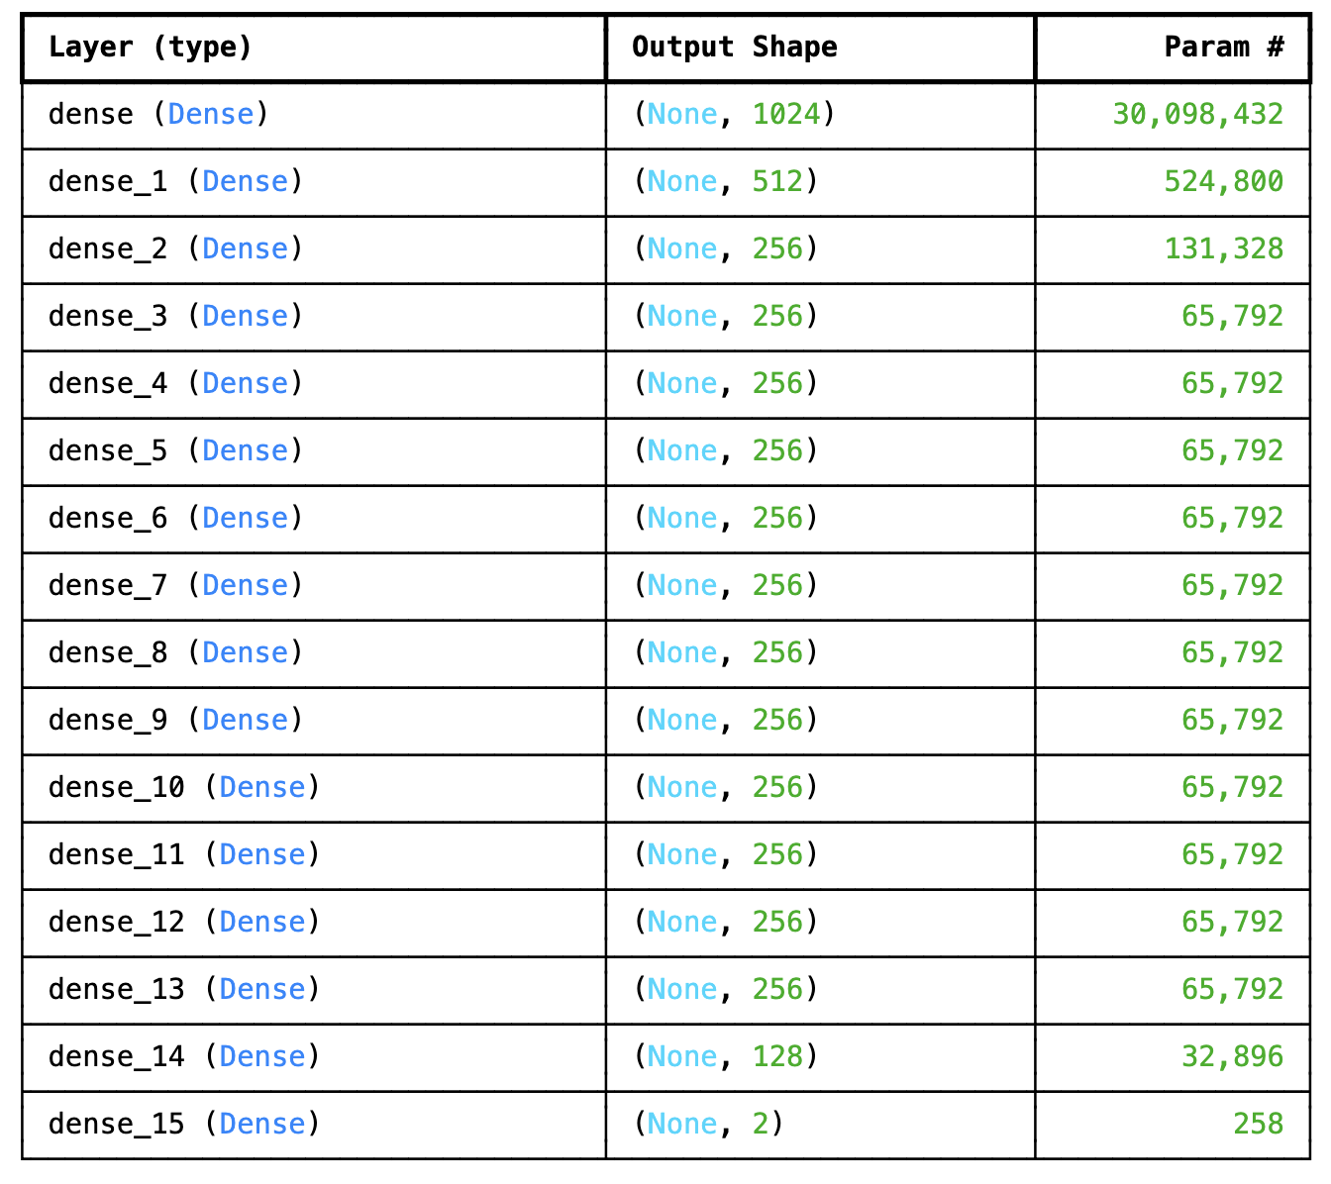
ANN Structure
Notes:
Sequential CNN, appropriate when you want to build a model layer-by-layer in a straight path.
Input Sizes = (batch_size, sequence_length, 4) 4 is for OHE amino acids
Convolution layer 1: The convolution scans across the sequence and learns 64 local feature detectors.
Max pooling: Downsamples the sequence by a factor of 2. Helps reduce the dimensionality and makes the learned features more robust by keeping only the maximum activation over small windows.
Convolution layer 2: 128 filter, Learns higher-level features based on the already extracted 64-filter features.
Global max pooling collapses the sequence dimension by taking the maximum value across the entire time axis for each of the 128 filters. Converts 3D input (batch, sequence, filters) to 2D (batch, filters). Useful when sequence length doesn't matter anymore and you want to reduce to a fixed-length feature vector.
Fully connected layers:
Adds a dense layer with 64 neurons, using ReLU activation. Processes the pooled features to make predictions.
Then Dropout layer Randomly sets 30% of inputs to 0 during training to help prevent overfitting. Encourages the model to not rely too heavily on any one neuron.
Final output layer: Number of neurons = number of classes (derived from the label encoder). Binary classification = 2 classes (human or non-human)
.softmax turns the output into a probability distribution over classes.

Slide 19
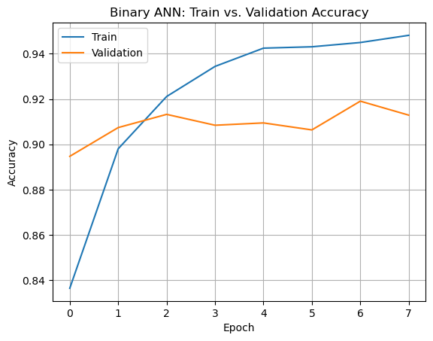
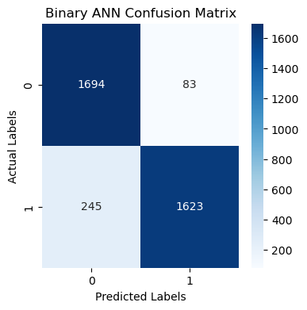
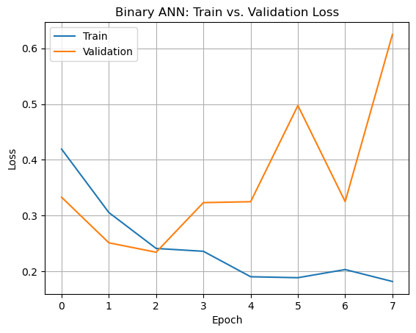
ANN Performance
Accuracy | Precision | Recall | F1-score
0.91 | 0.91 | 0.91 | 0.91
Notes:
Training 80%, validation 20%
Binary cross entrapy
Training accuracy peaks ~0.945 Validation accuracy peaks ~0.93
The gap between training and validation accuracy is relatively small, which is a good sign (limited overfitting).
For loss graph:
Importantly, validation loss does not increase, suggesting no clear overfitting yet, but it's nearing the point where it might.
If increase the epochs might start overfitting

Slide 20
Agenda
1.
Defining the Problem
2.
Data Source
3.
Data Cleaning / EDA
4.
Binary classification ANN
5.
Binary classification CNN
6.
Multi species Classification CNN
7.
Identifying Predictive RNA Regions
8.
Autoencoder + Transformer
9.
Conclusion and Next Steps

Slide 21
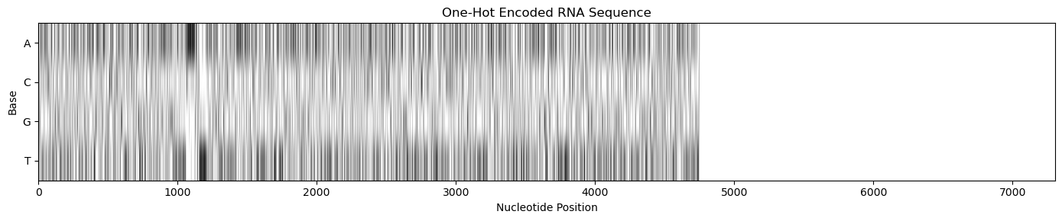
CNN Input Image

Slide 22
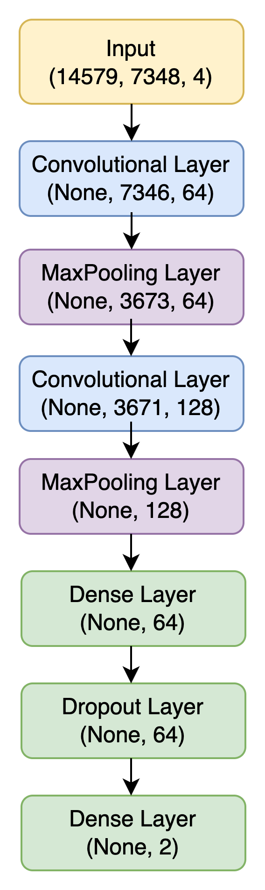
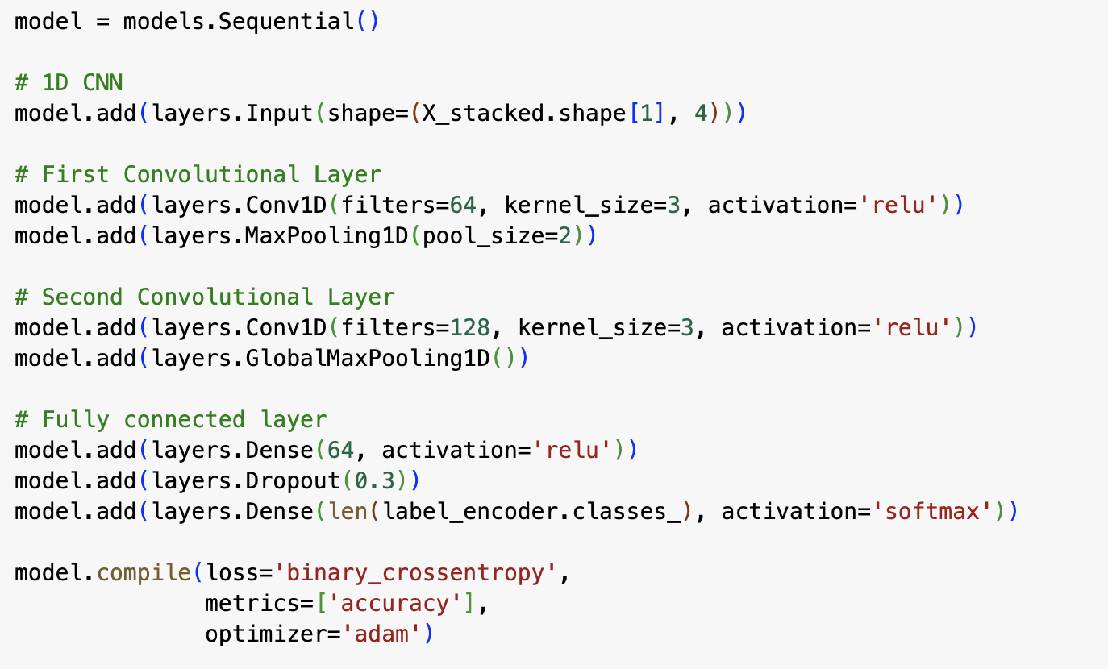
CNN Structure
Notes:
Sequential CNN, appropriate when you want to build a model layer-by-layer in a straight path.
Input Sizes = (batch_size, sequence_length, 4) 4 is for OHE amino acids
Each pixel = 1 nucleotide
Convolution layer 1: The convolution scans across the sequence and learns 64 local feature detectors.
Max pooling: Downsamples the sequence by a factor of 2. Helps reduce the dimensionality and makes the learned features more robust by keeping only the maximum activation over small windows.
Convolution layer 2: 128 filter, Learns higher-level features based on the already extracted 64-filter features.
Global max pooling collapses the sequence dimension by taking the maximum value across the entire time axis for each of the 128 filters. Converts 3D input (batch, sequence, filters) to 2D (batch, filters). Useful when sequence length doesn't matter anymore and you want to reduce to a fixed-length feature vector.
Fully connected layers:
Adds a dense layer with 64 neurons, using ReLU activation. Processes the pooled features to make predictions.
Then Dropout layer Randomly sets 30% of inputs to 0 during training to help prevent overfitting. Encourages the model to not rely too heavily on any one neuron.
Final output layer: Number of neurons = number of classes (derived from the label encoder). Binary classification = 2 classes (human or non-human)
.softmax turns the output into a probability distribution over classes.
Loss function = binary cross entropy

Slide 23
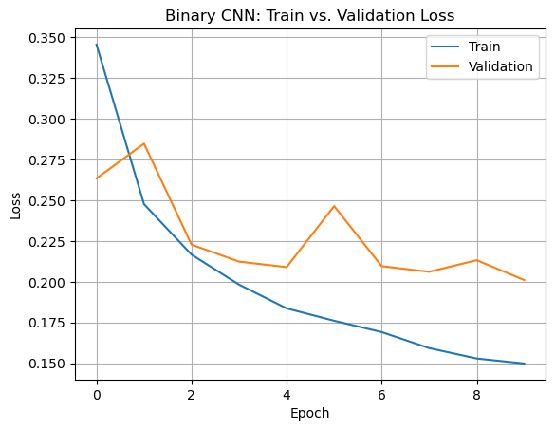
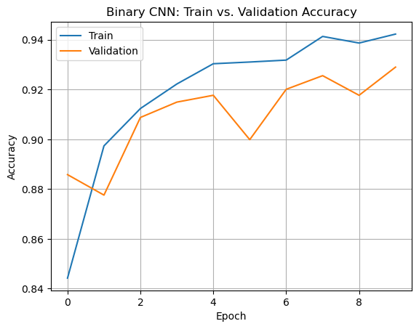
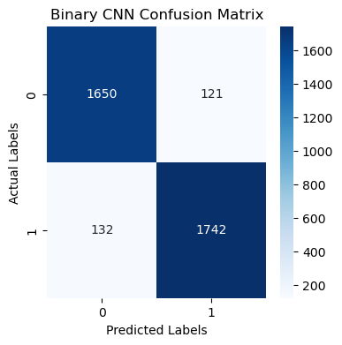
Performance
Accuracy | Precision | Recall | F1-score
0.93 | 0.93 | 0.93 | 0.93
Notes:
Training 80%, validation 20%
Training accuracy peaks ~0.945 Validation accuracy peaks ~0.93
So we configured the model to run on 100 epochs but here you can see it actually only goes to ~10 epochs
This is because we applied an “early stopping method” which automatically stops the epochs once we stop improving the loss/accuracy
Meaning we prevent overfitting

Slide 24
Agenda
Science Presentation
1.
Defining the Problem
2.
Data Source
3.
Data Cleaning / EDA
4.
Binary classification ANN
5.
Binary classification CNN
6.
Multi species Classification CNN
7.
Identifying Predictive RNA Regions
8.
Autoencoder + Transformer
9.
Conclusion and Next Steps

Slide 25
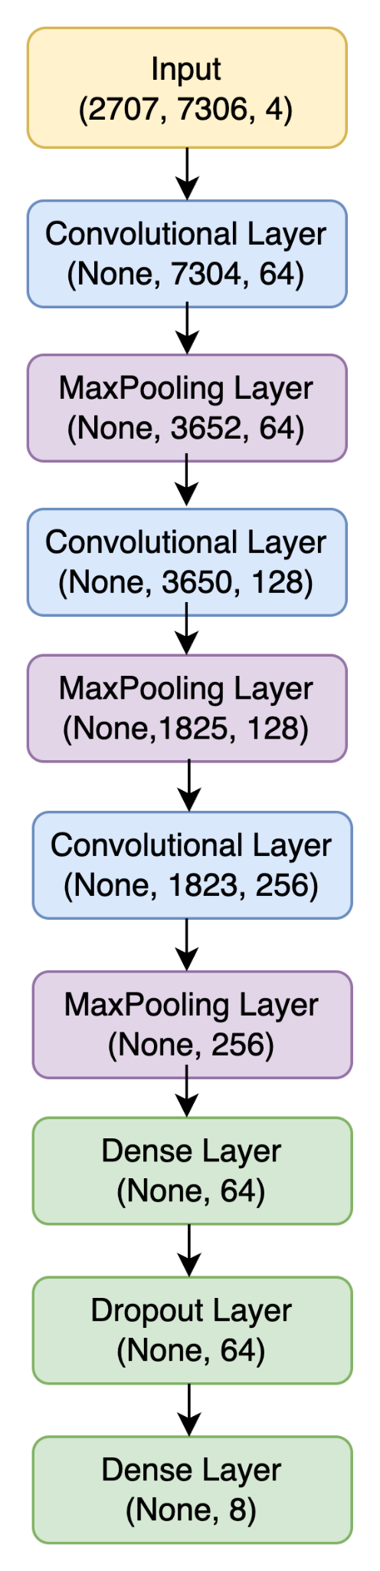
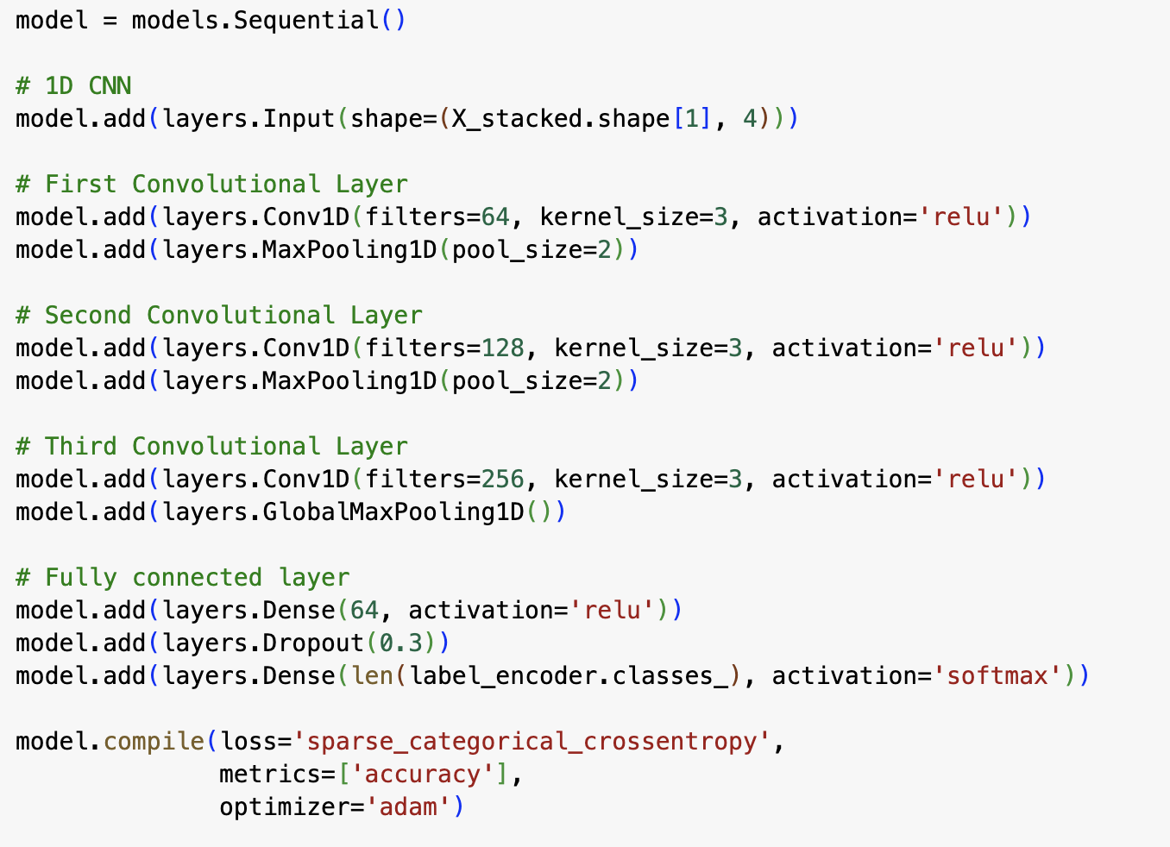
CNN Structure
Notes:
More layers!
Needed to add a third convolutional layer, with 256 filters
Increasing to more filters Allows the network to learn a richer and more expressive set of features at a deeper level.
Compensates for the fact that spatial (sequence) size is getting smaller (due to pooling), so the network has to encode more information per channel.

Slide 26
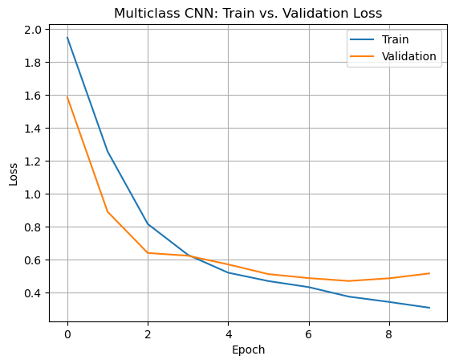
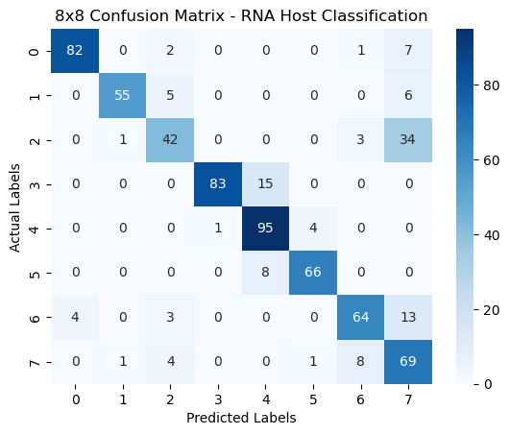
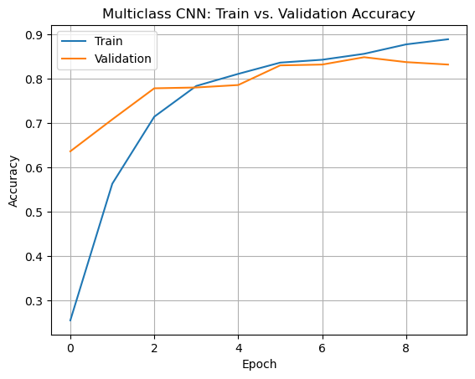
Performance
Accuracy | Precision | Recall | F1-score
0.82 | 0.85 | 0.82 | 0.82
Notes:
Training 80%, validation 20%
Training accuracy peaks ~0.945 Validation accuracy peaks ~0.93
The gap between training and validation accuracy is relatively small, which is a good sign (limited overfitting).
For loss graph:
Importantly, validation loss does not increase, suggesting no clear overfitting yet, but it's nearing the point where it might.
If increase the epochs might start overfitting

Slide 27
Agenda
1.
Defining the Problem
2.
Data Source
3.
Data Cleaning / EDA
4.
Binary classification ANN
5.
Binary classification CNN
6.
Multi species Classification CNN
7.
Identifying Predictive RNA Regions
8.
Autoencoder + Transformer
9.
Conclusion and Next Steps

Slide 28
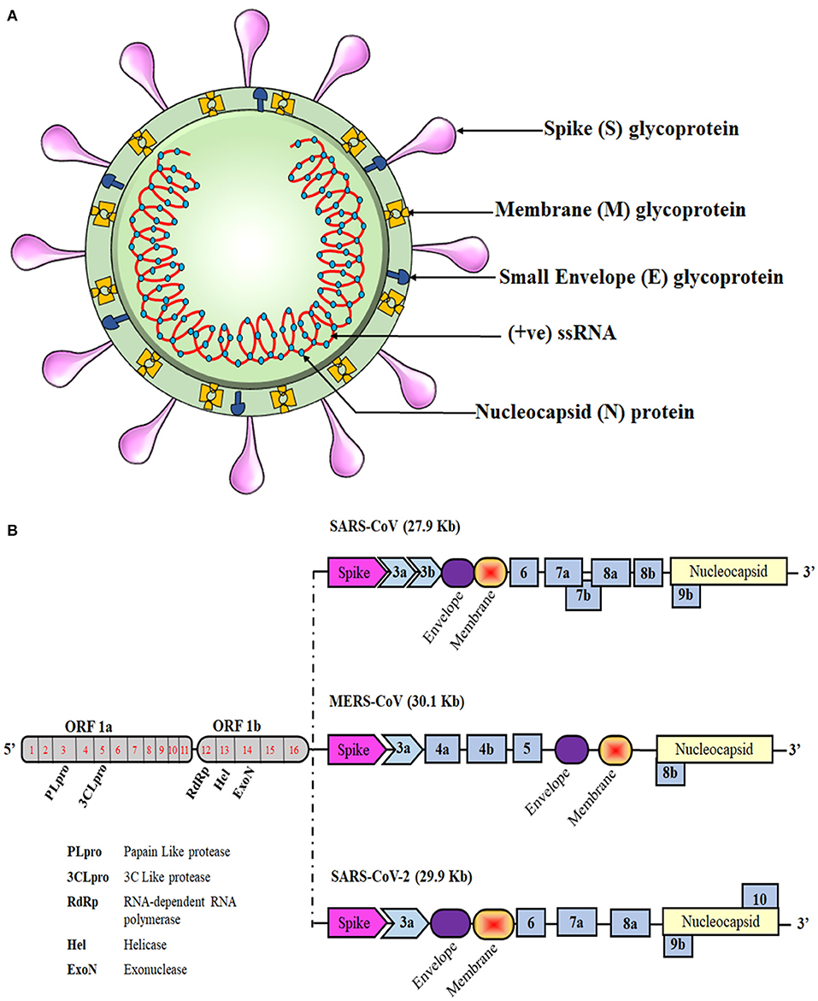
Identifying Predictive RNA Regions for Viral Host Classification
Our CNN achieved high accuracy for multi species classification - but which features were most important?

Slide 29
Approach - Sliding Window Deletions Effect on Model Entropy
Window Size
ssRNA Sequence
Stride Length
Delete short section of RNA
Pad the end of the sequence (in addition to existing padding)
Pass sequence into the pre-trained multispecies CNN
Measure model entropy
Slide deletion window specified number of nucleotides along sequence and repeat steps
Compare entropy values across deletion locations
ssRNA Sequence
Padding
Pre Trained Multispecies CNN
Prediction Uncertainty (Entropy)

Slide 30
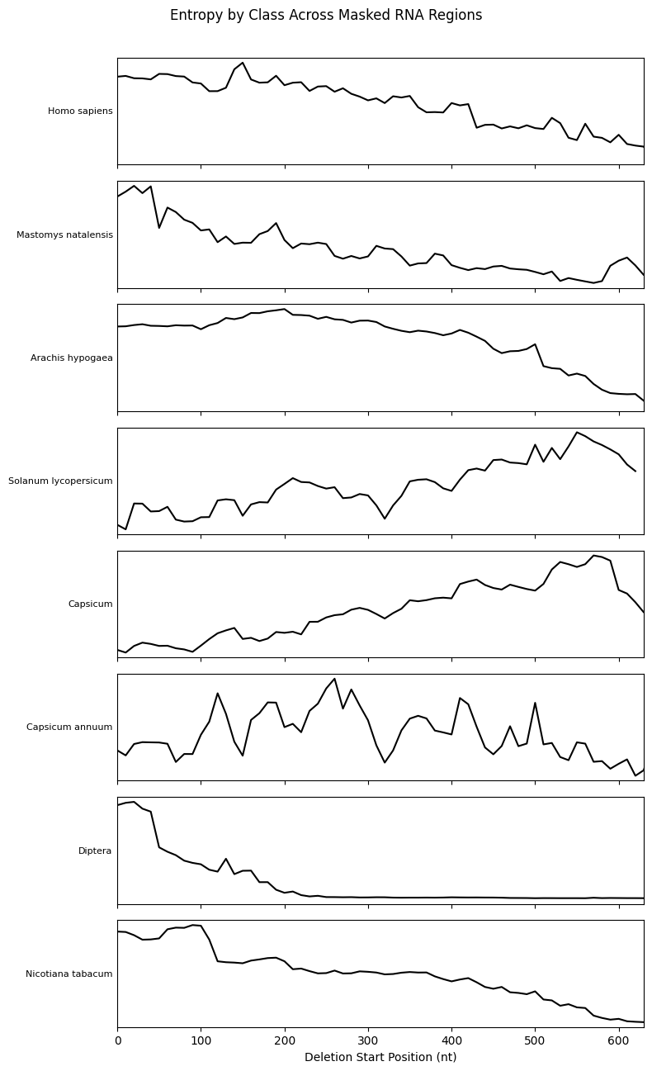
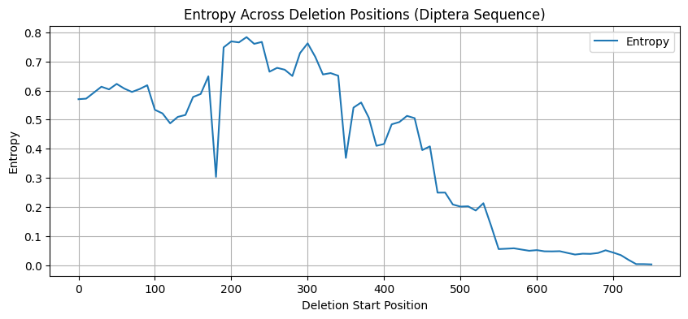
Interpreting the Entropy Plots
High entropy → model is uncertain; deleted region likely important for host classification
Low entropy → model is confident; deleted region has little effect on prediction
Can analyze single sequences or average across sequences within a species
For stacked plots, filtered to 650–800 nt sequences for clarity

Slide 31
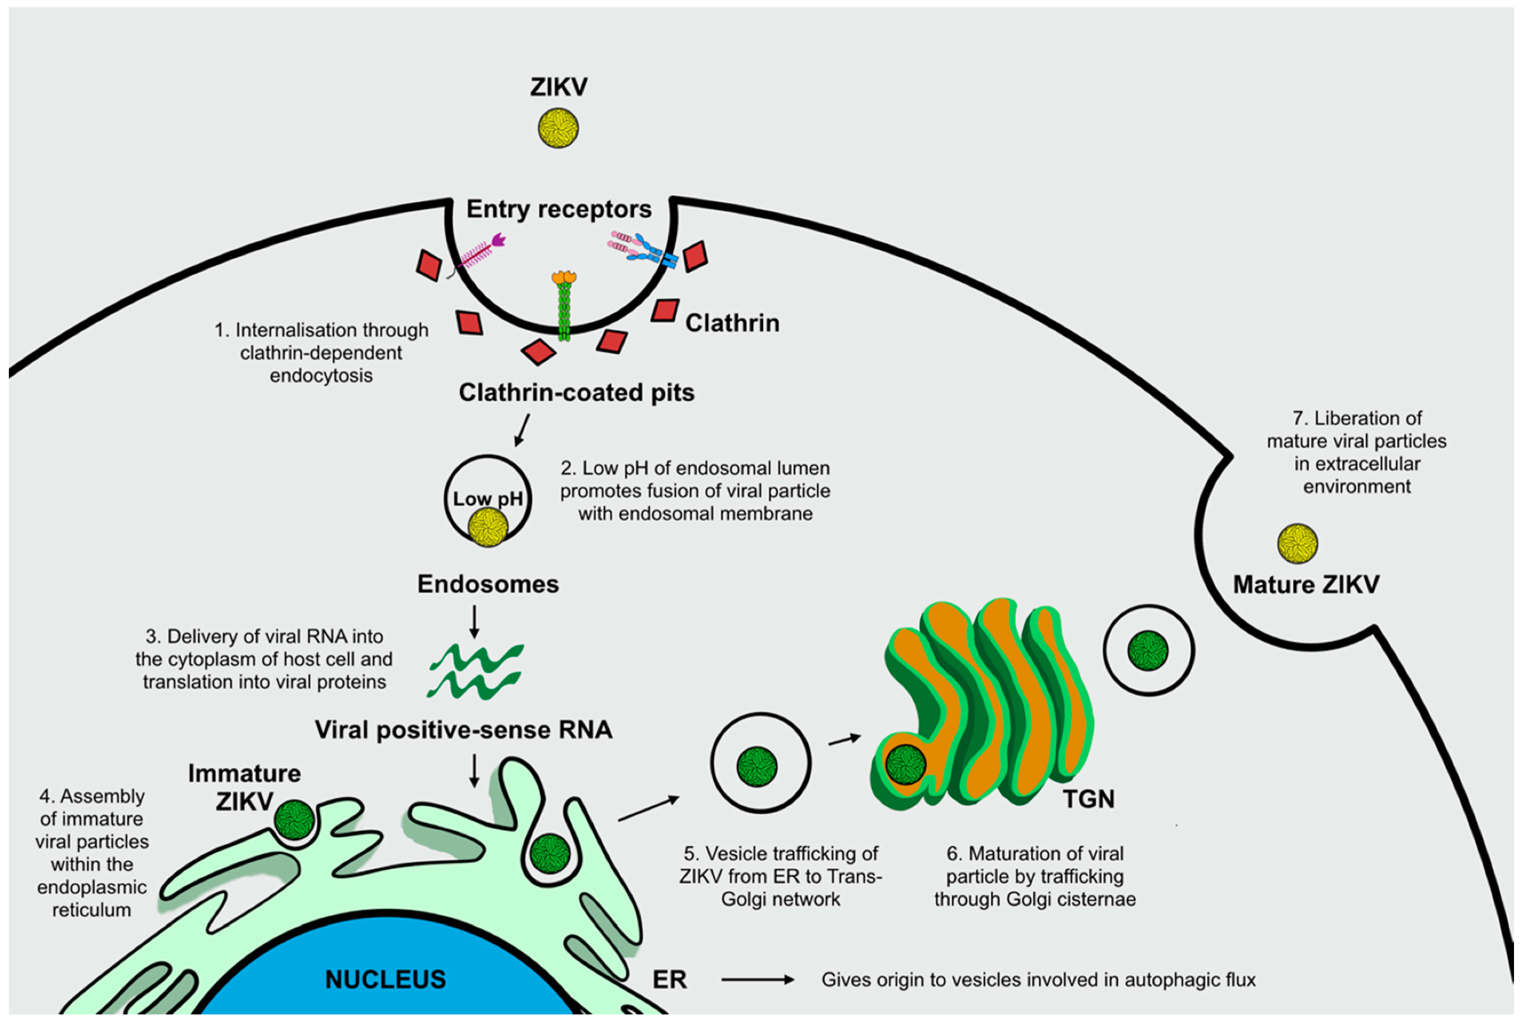
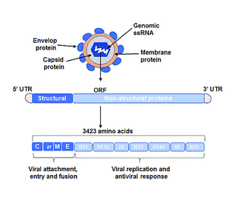
Biological Significance and Utility in Virology Research
Predictive regions may encode structural proteins for host-specific binding
Offers insight into viral entry mechanisms and potential therapeutic targets
Crucial for rapid-response efforts against mutating viruses

Slide 32
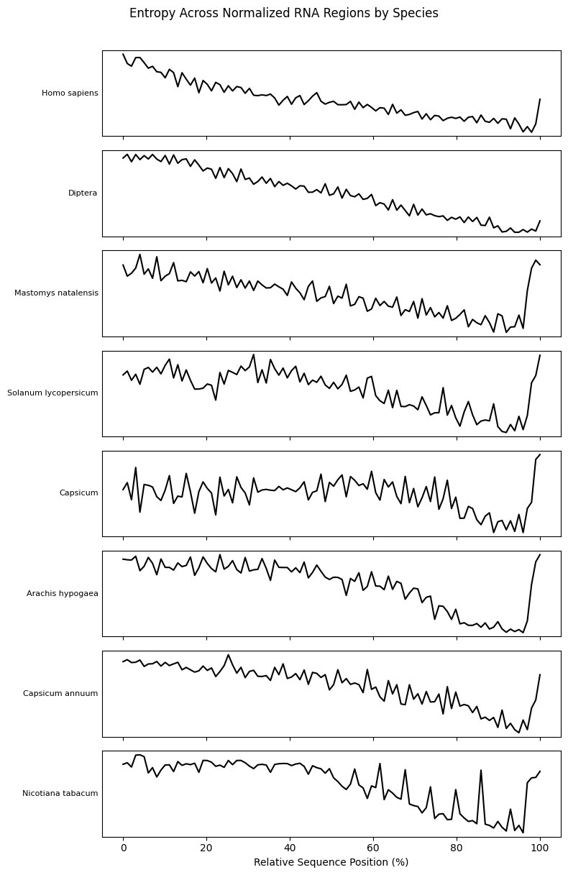
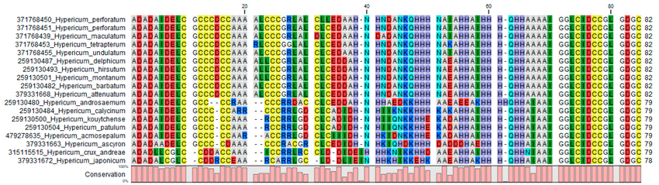
Next Steps to Generalize This Analysis
Identify conserved motifs within high-entropy (high-importance) regions
Extend analysis to include sequences of varying lengths
Use entropy-informed regions to guide sequence alignment and motif discovery

Slide 33
Agenda
1.
Defining the Problem
2.
Data Source
3.
Data Cleaning / EDA
4.
Binary classification ANN
5.
Binary classification CNN
6.
Multi species Classification CNN
7.
Identifying Predictive RNA Regions
8.
Autoencoder + Transformer
9.
Conclusion and Next Steps

Slide 34
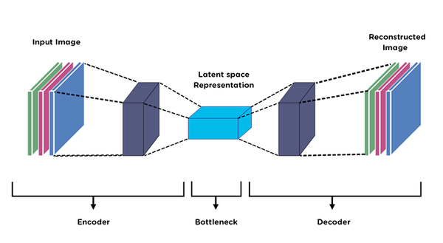
AutoEncoder Architecture
Transformer
Encoder
Bottleneck layer
Decoder
Notes:
In addition to our CNN we also implemented an autoencoder to determine which portion of the RNA was most significant with regards to species classification.

Slide 35
AutoEncoder Architecture
Encoder
Decoder
Input Layer
Input Layer
(1-D Convolutional + 1-D Maxpooling) X 3
Dense Layer
Flattening Layer
(1-D Conv + Batch Normalization + ReLu) x 3
Latent Vector
Final 1-D Convolutional Layer
Notes:
This is the structure of our autoencoder. You can see here that its design is fairly similar to that which we implemented in assignment 5. In order to normalize the input, the sequences are truncated to 1000 nucleotides. As with our earlier models, we also implemented early stopping so as to avoid overfitting of our model.

Slide 36
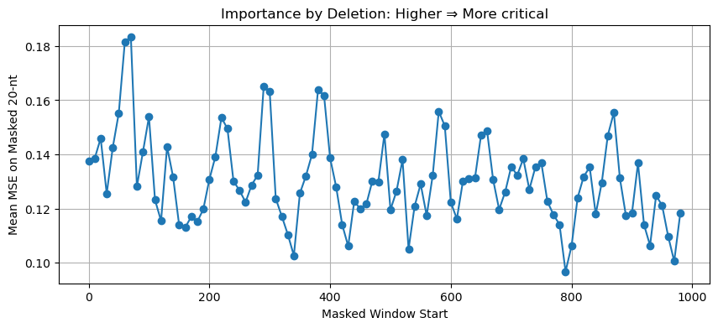
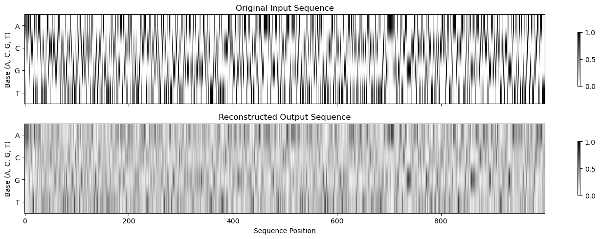
Applications of AutoEncoder
Train on Data Set
Using sliding window delete sections
Make prediction on new sequence
Plot all reconstruction error by index of window
Areas of particularly poor reconstruction indicate that this is significant to classification
Notes:
Similar to our previous model, here we implemented a sliding window in order to evaluate which regions of the RNA are most significant for classification. As the window moves through the sequence, the target region is removed from the sequence and then that sequence sans target is passed into the autoencoder. This is done for the entire length of the sequence. Regions that have high reconstruction error are considered to be more significant for classification. As can be observed in this example plot, we determined that often times, there are multiple segments of our sequence that contribute to the classification, not just a single window.

Slide 37
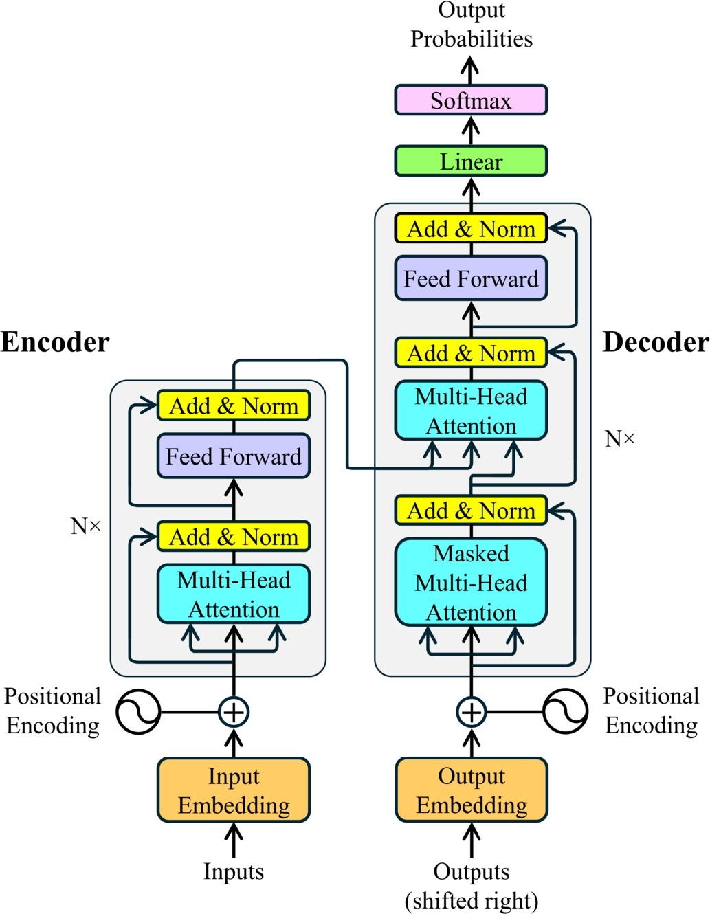
Transformer Architecture
Transformer
Tokenizers
Positional Encoding
Transformer layers
Un-embedding layer
Chaturvedi, M., Rashid, M. A., & Paliwal, K. K. (2025). Transformers in RNA structure prediction: A review. Computational and Structural Biotechnology Journal. https://doi.org/10.1016/j.csbj.2025.03.021
Notes:
This leads us into our final portion of our pipeline. Here we implemented a fairly simple transformer, used to predict the identity of missing nucleotides. A quick summary of transformer architecture, it’s a fairly new technology which provides powerful predictive capabilities over long ranges of data. It includes a Tokenizer, Positional Encoding, the actual Transformer Layers, and an Un-embedding layer which provides an output probability.

Slide 38
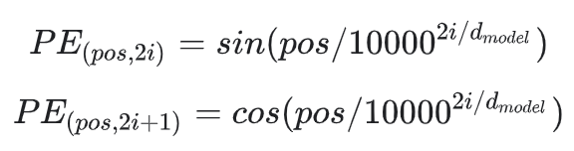
Our Model Design
Tokenizer
Sequence is encoded into integer representations
Our data set is passed into mask_tokens() which randomly selections an assigned ratio and replaces with a [Mask] token which the model is trained to predict.
Masked sequence and original sequence are passed on for training
Embedding Layer
Converts tokens into vectors
These enables the model to identify each token based on it’s position in the sequence
Enables relationships between tokens to be quantified
Notes:
Next I’ll provide an overview of our actual implementation of this architecture. The tokenizer converts each nucleotide into an integer, following this, a copy of the sequence is created. In this copy, random locations are replaced with a [MASK] token. This mask token communicates to the transformer that this is a location that requires a prediction to be made. Both the original sequence and this Masked copy are passed onto later layers for Training. Next, this data is passed into a positional encoding layer. The basic functionality of this layer, is to map all tokens into a high dimensional vector via the wave functions shown below. This enables not only the identify, but also the relative positions to be captured by the model. So the relationship between 1 nucleotide and any other in the sequence is represented in this vector space.

Slide 39
Transformer
MulitHeadAttention
After passing through an embedding layer, our data is passed through the model outlined in the diagram to the left
Attention - Allows tokens to “pay attention to each other”
Multi-headed attention allows model to focus on multiple positions in parallel
Normalization - Stabilizes training and shifts activation of network weights
Dense Layers
Dropout - Prevents overfitting
Repeat
Loss function is categorical cross entropy
LayerNormalization
Repeats over the amount of declared layers
Two Dense Layers
LayerNormalization
Dropout
Notes:
Following Embedding, our data is passed into the main network portion of our model. One of the most important components of a transformer is the idea of Self-attention. It allows each token in the input sequence to "attend" to all other tokens, essentially determining the context and relationships between them. Transformers often employ multi-head attention, which we do in this case, where the attention mechanism is applied multiple times in parallel, each with its own set of Query, Key, and Value weights. This allows the model to capture different relationships and patterns in the input sequence simultaneously. Additionally, the normalization layers stabilizes our training and prevents particular neurons from becoming overweighted by normalizing the weights and shifting it across the network. As well as this, there are dense layers followed by a dropout layer to control any sort of overfitting that may be occurring in our process. This is repeated over a certain number of iterations, which the default being twice. The final output of this model will be a probability using softmax which is then converted back into a token.

Slide 40
Summary
Input
A C T A [MASK] G T A
model.predict
Output
A C T A T G T A
Notes:
This is a complicated way of saying, this sequence is missing a nucleotide, guess which one it should be.

Slide 41
Agenda
Science Presentation
1.
Defining the Problem
2.
Data Source
3.
Data Cleaning / EDA
4.
Binary classification ANN
5.
Binary classification CNN
6.
Multi species Classification CNN
7.
Identifying Predictive RNA Regions
8.
Autoencoder + Transformer
9.
Conclusion and Next Steps

Slide 42
Limitations
Poor Autoencoder Reconstruction Accuracy
Antigen’s have variable length
Model only takes primary structure into account
Cannot say with confidence which regions are actually impactful
Sliding window does not take this into account
Binding Affinity is influenced by the overall shape of the RNA and not just the specific nucleotides in the sequence
Notes:
While we’re very pleased with how our pipeline turned out, we do have to note that it does have several limitations in its current state. Firstly, our Autoencoder has poor reconstruction accuracy, this compromises the confidence of our conclusion as to which regions are most significant, although you could make the argument that regions of interest are determined off of their relative reconstruction error. Additionally, our current version of the model has a staticly sized sliding window. If a particular sequence has a binding region that is not equal in length to that window, then this information won’t be captured completely by the autoencoder. Lastly, our model only takes into account primary structure of sequences. As I’m sure many of you are aware, the abilities of different molecules to interact with eachother can be heavily dependent on their ability to fold and twist into the correct shape in a lock and key mechanism. Because our model does’t capture this currently, we almost certainly are missing out on relevant information.

Slide 43
Future Work - Putting it all together
Classify
Segment
Predict
Reclassify
Predict Species of interest (using multi-species CNN)
Find Key sub-sequences (using autoencoder)
Introduce Likely Mutations (using transformer)
See if Species Classification Changes (using original multi-species CNN again)
Notes:
Here’s an overview of the overall pipeline we’ve developed thus far. With a trained set of models, we can perform the following analysis of an unknown RNA virus. We initially perform the species classification, if it’s determined that it will not infect humans then we proceed with additional analysis. Next we run the sequence through the autoencoder in order to determine regions of interest. After which, we’ll introduce likely mutations with our transformer, mimicking real world rapid mutation of viruses. Finally, we will pass this modified sequence back into our CNN and observe if the classification changes. In summation, the goal of our project is to create a model which can identify viruses which don’t currently infect humans that are likely to mutate into new versions that do infect humans. The goal is to be able to identify these pathogens early on, so to start early development of treatments and public safety measures, before it becomes a widespread pandemic.

Slide 44

Closing Thoughts
Drawing a Conclusion
Science Presentation
This has been an incredibly fun project that we plan on continuing to work on and improve. Thanks to Professor Markus and Vineeth for teaching an amazing course this semester!
Professor Markus surfing through space (circa 2025)
Notes:
Overall, this was an incredibly fun project to work on. I’ve talked with my group members and we’re all excited to continue work on this project and to more fully realize it’s developmental potential. I want to offer a big thank you to both Markus and Vineeth for offering us a very enjoyable course. I also personally want to offer a shout out to my group mates who have been an absolute joy to work with, our calls have consistently been very fun and a highlight of my weeks throughout this semester. Lastly, I want to thank all of our peers in attendance for showing up to watch us present on a Friday night. With that being said, have a great summer everyone!

Slide 45
References
Bruslind, Linda. “22: The Viruses.” Biology LibreTexts, 6 Feb. 2018, bio.libretexts.org/Bookshelves/Microbiology/Microbiology_%28Bruslind%29/22%3A_The_Viruses.
Chen, Guowei, et al. “RNAVirHost: A Machine Learning–Based Method for Predicting Hosts of RNA Viruses through Viral Genomes.” GigaScience, vol. 13, 1 Jan. 2024, pmc.ncbi.nlm.nih.gov/articles/PMC11340644/, https://doi.org/10.1093/gigascience/giae059. Accessed 5 Dec. 2024.
Chaturvedi, Mayank, et al. “Transformers in RNA Structure Prediction: A Review.” Computational and Structural Biotechnology Journal, vol. 27, 17 Mar. 2025, pp. 1187–1203, www.sciencedirect.com/science/article/pii/S200103702500090X, https://doi.org/10.1016/j.csbj.2025.03.021.

